Slide 1

Mausam vibhag - Weather Forecast web-App
SCHOOL OF COMPUTER SCIENCE AND ENGINEERING M.C.A. (MASTER IN COMPUTER APPLICATION)
Team Members
Nikhil Saraogi [21MCA1080]
Lakshya [21mca1056]
Under the Guidance of
Dr. Graceline Jasmine S
Notes:
We designed this template so that each member of the project team has a set of slides with its own theme. Members, here’s how you add a new slide to just your set:
Mark where you want to add the slide: Select an existing one in the Thumbnails pane, click the New Slide button, then choose a layout. The new slide gets the same theme as the other slides in your set.
Careful! Don’t annoy your fellow presenters by accidentally changing their themes. That can happen if you choose a different theme from the Design tab, which changes all of the slides in the presentation to that look.

Slide 2
Introduction
A weather forecast app is web-based application to get weather updates and any other climatic changes. In this project, we will made a weather forecast application using Streamlit and PYOWM libraries in Python and then deploy the project on Heroku platform which is absolute free hosting platform.
VIT - CHENNAI

Slide 3
Concepts used in this project:
Application Development
API calls
Data Visualisation
GitHub Integration (Heroku GitHub Deploys)
VIT - CHENNAI

Slide 4
Features:
Getting Weather forecast using Open Weather API
City name based querying
Parameters: Temperature, Wind speed, Cloud coverage, Sunrise & Sunset time, Graphical representation
VIT - CHENNAI

Slide 5
Tools & Technologies used:
Python
Streamlit
Open Weather Map
Matplotlib
PYOWM
Heroku
VIT - CHENNAI

Slide 6
Step 1: Installation of required package:
pip install streamlit
pip install pyowm
pip install matplotlib
VIT - CHENNAI

Slide 7
Step 2 : API generate and integrate with pyowm
We have to register an account on https://openweathermap.org/and generate an API Key for Current Weather Data.
API key:-8b0b4a6b5bef32eaa4ce78f48da0830d
And ,then initialize Pyowm with an API key.
VIT - CHENNAI

Slide 8
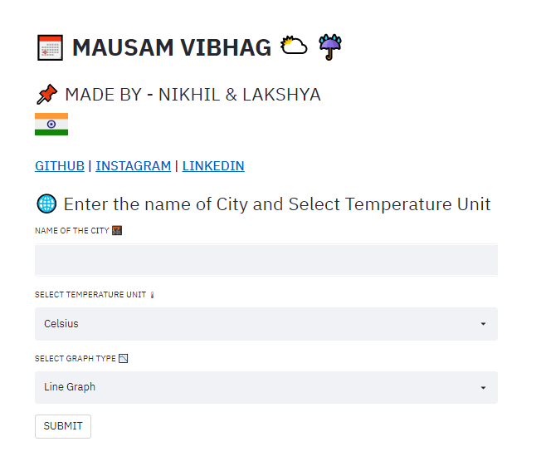
Step 3:display page
By Using Streamlit library:
VIT - CHENNAI

Slide 9
Step 4 : ABOUT MAIN FUNCTION
We take the city Name as input and call the weather_manager() instance to fetch the weather data for that place.
Unlike the previous step where we called the temperature values, now we call the clouds and the wind functions.
Similarly, like the previous ones, to get the sunset and sunrise time, we call the sunset_time(‘iso’) and sunrise_time(‘iso’) functions of the weather object.
VIT - CHENNAI

Slide 10
Step 5:Plotting Graphs and Calculations using matplotlib.
The plot_line() and plot_bar() function is called by the our weather_detail() function.
Human- perceivable format, we use the dates.date2num and the set_major_formatter() function.
Now as per the user input we get the graphs plotted using the plt.plot(for line graph) and plt.bar(for bar graph).
To print the graphs in Streamlit we use the st.pyplot() just like our standard plt.show().
VIT - CHENNAI

Slide 11
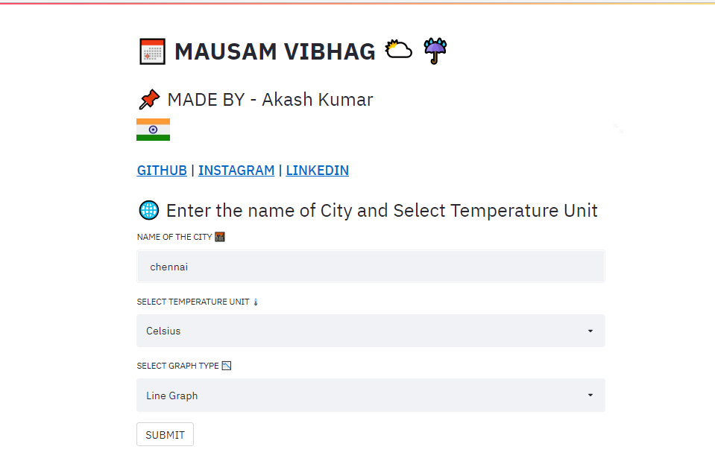
AFTER IMPLEMENTATION (LOCAL HOST)
VIT - CHENNAI

Slide 12
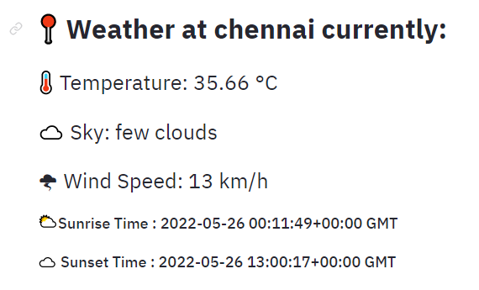
WEATHER DETAILS
VIT - CHENNAI

Slide 13
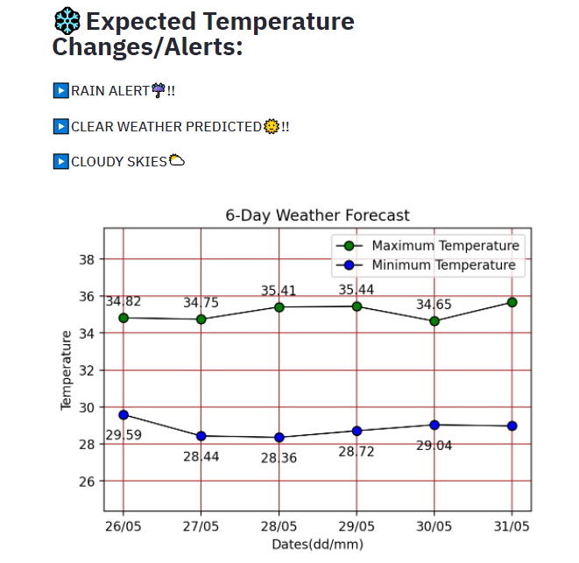
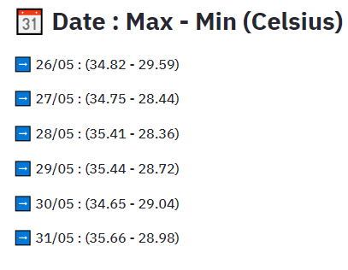
Weather forecast with graph
VIT - CHENNAI

Slide 14
Steps for deployment-
Step1: Before beginning to deploy the app, there are very important steps that need to be followed in order to avoid errors ahead.
- Create a requirements.txt file and write all the packages used in the project including their versions. Ex. pyowm==3.0.0
- Create a runtime.txt file and include your python version in it.
- Create a Procfile which consist of command for the Heroku Server. (web: sh setup.sh && streamlit run script.py)
VIT - CHENNAI

Slide 15
Step2: Create a Github repository.
Step3: Create account on Heroku Platform and login to it. Create a new project on Heroku.
Step4: Click deploying app and select Github Integration. Also connect Github to Heroku.
Step5: In manual deploy, Finally Click Deploy and wait till it gives you textbox to view deployed app.
VIT - CHENNAI

Slide 16
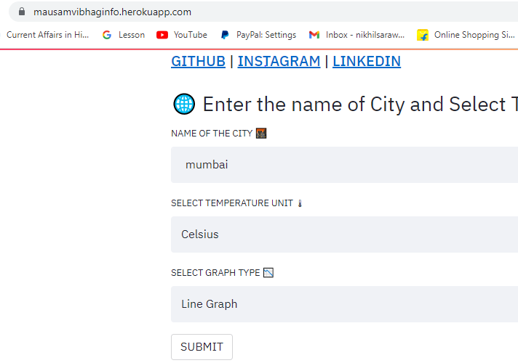
After deployment-
Link -https://mausamvibhaginfo.herokuapp.com/
VIT - CHENNAI

Slide 17
Thank you
VIT - CHENNAI

